Slide 1
Welcome to eCom Manifest
Developer Onboarding

Slide 2
Agenda
What Manifest does
How to use it
Error Handling
How to get help

Slide 3
What manifest does
Services manifest describes an env with all the services the env is using
Source of truth for software artifact versions
Deploy all of the services
On manifest update, deploy the updates to the env
Services supported
Helm Packaging service
Legacy helm packaging service
VM based service

Slide 4
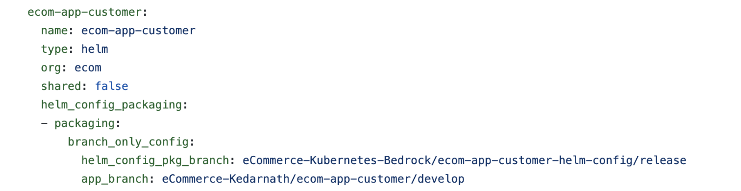
How to use it – Non shared service
Each env has its own manifest file
Manifest defines two types of services
Non shared service (Each env has its own instance)
Shared service (Shared by multiple env)
For non-shared service, env manifest itself is the owner of the service and defines its definition such as the app version, packaging details
Snippet from qa45 manifest for a non-shared service

Slide 5
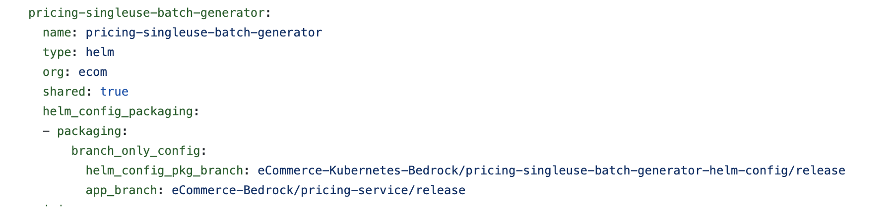
How to use it – Shared service (Owner)
For a shared service, env manifest is either the owner of the service or a consumer of the service
Shared service definition in the owner manifest
This is same as defining a non-shared service
Snippet from qa2 services manifest
pricing-singleuse-batch-generator is a shared service with env as qa2

Slide 6
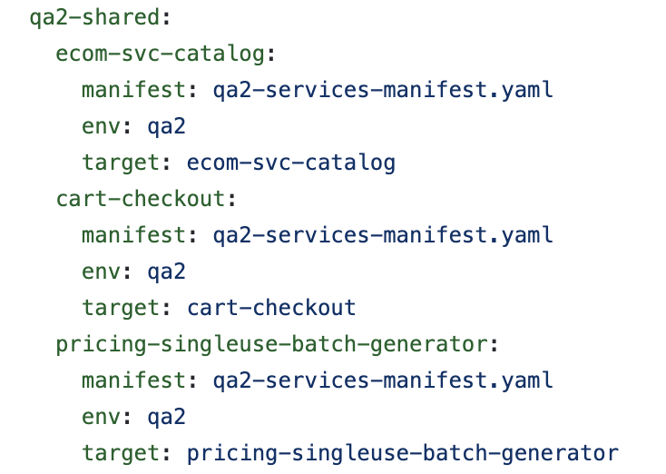
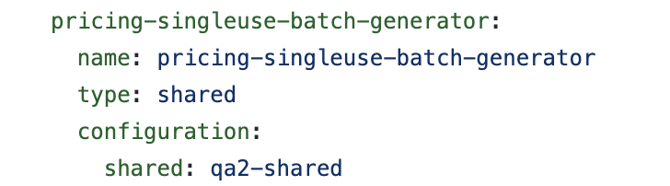
How to use it – Shared service (Consumer)
Shared service definition in the consumer manifest
Here the manifest is the consumer of the shared service which is defined in the owner manifest
Service is defined in the manifest as type: shared along with an additional shared pointer shared: <env-pointer>
Snippet from qa45 services manifest
pricing-singleuse-batch-generator as an example of a shared service consumed by qa45 env and is defined in qa2 env
The shared: qa2-shared is a pointer to look for the owner manifest env in the shared registry
Shared registry
Snippet from shared registry qa2-shared pointer for pricing-singleuse-bactch-generator
manifest field indicates the owner manifest file name
env field indicates the env name of the service in the owner manifest
target field indicates the name of the service in the owner manifest

Slide 7
How to use it – Update manifest
Fork and clone the env-manifest repo for your team org if not already
Update the manifest file with changes
Example – new version of service, new branch to use for a service
Submit PR to bedrock release branch
Approval requirements for shared service updates
On PR merge, changes are applied to the env

Slide 8
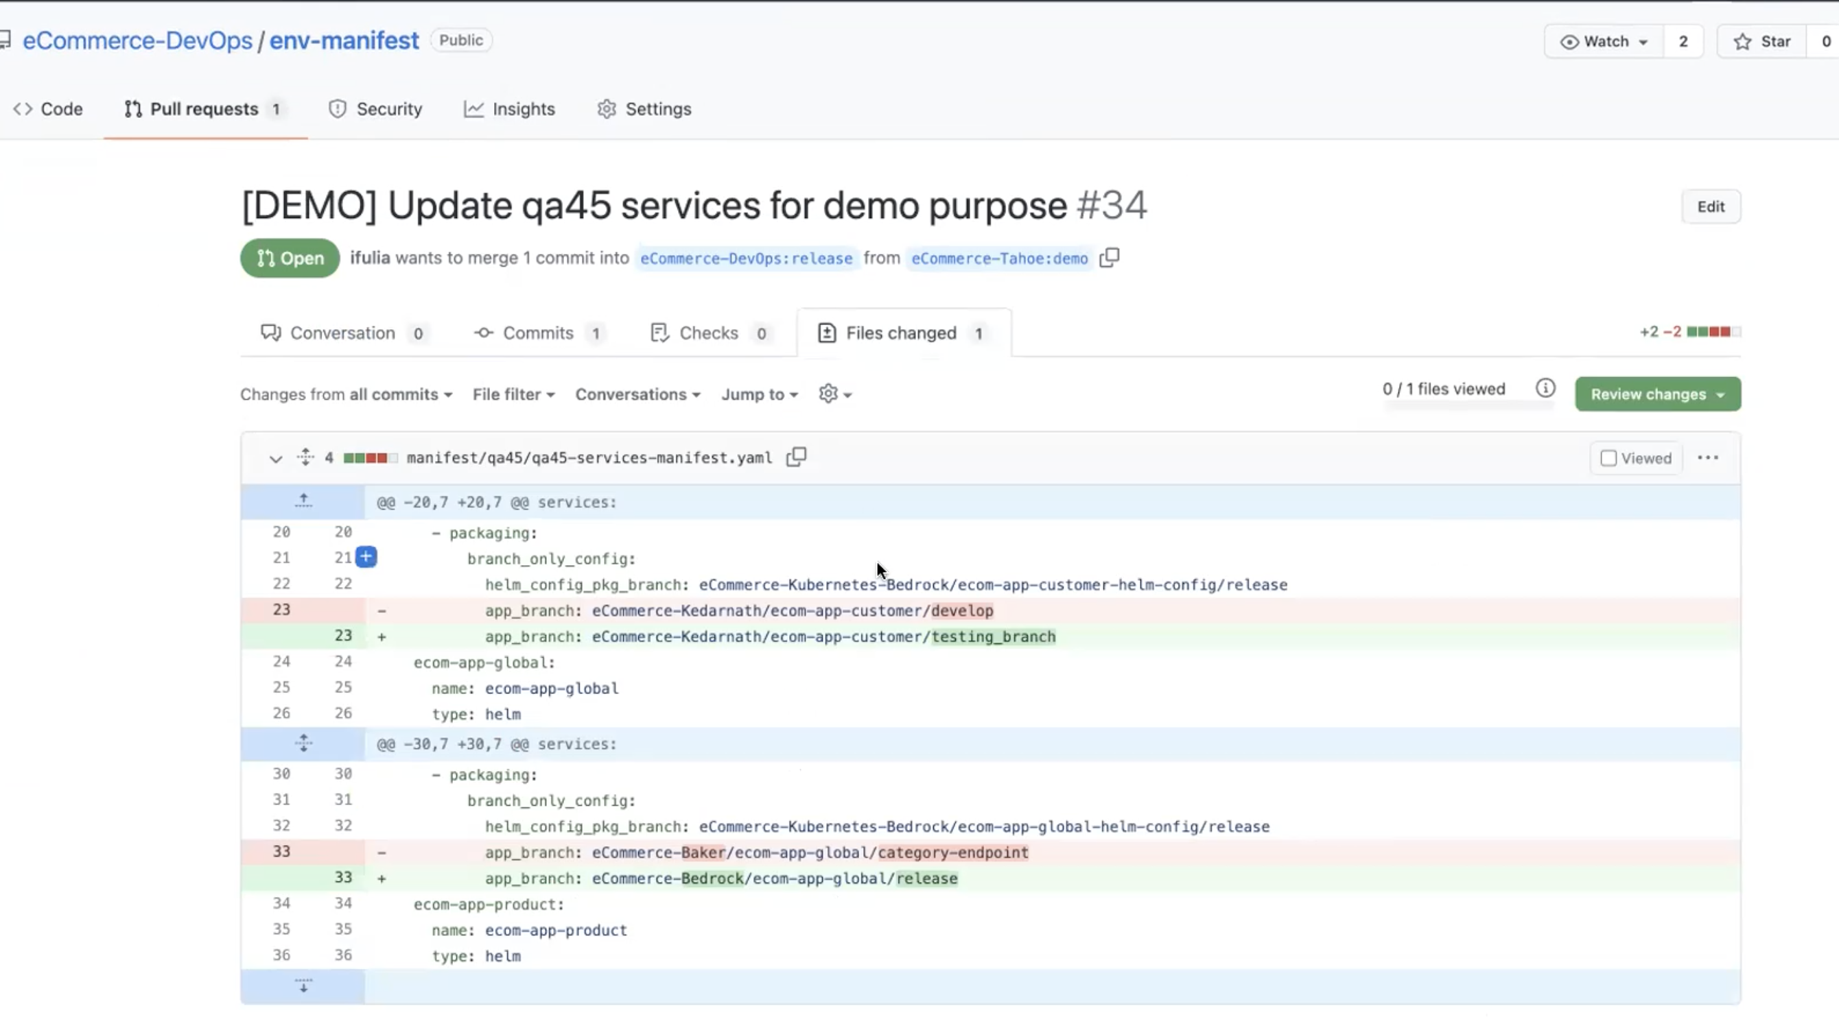
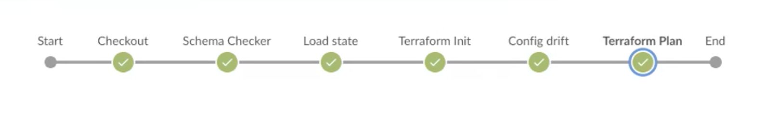
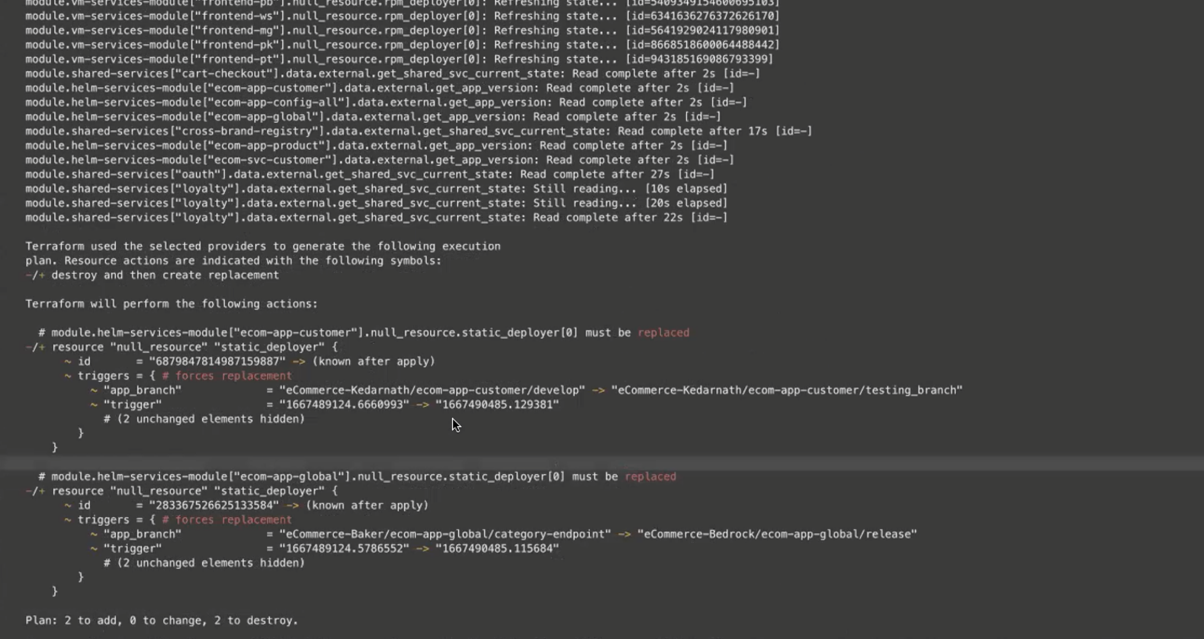
How to use it – Planning vs Applying
On submitting PR, the Jenkins build gets you planning information saying what’s going to be changed

Slide 9
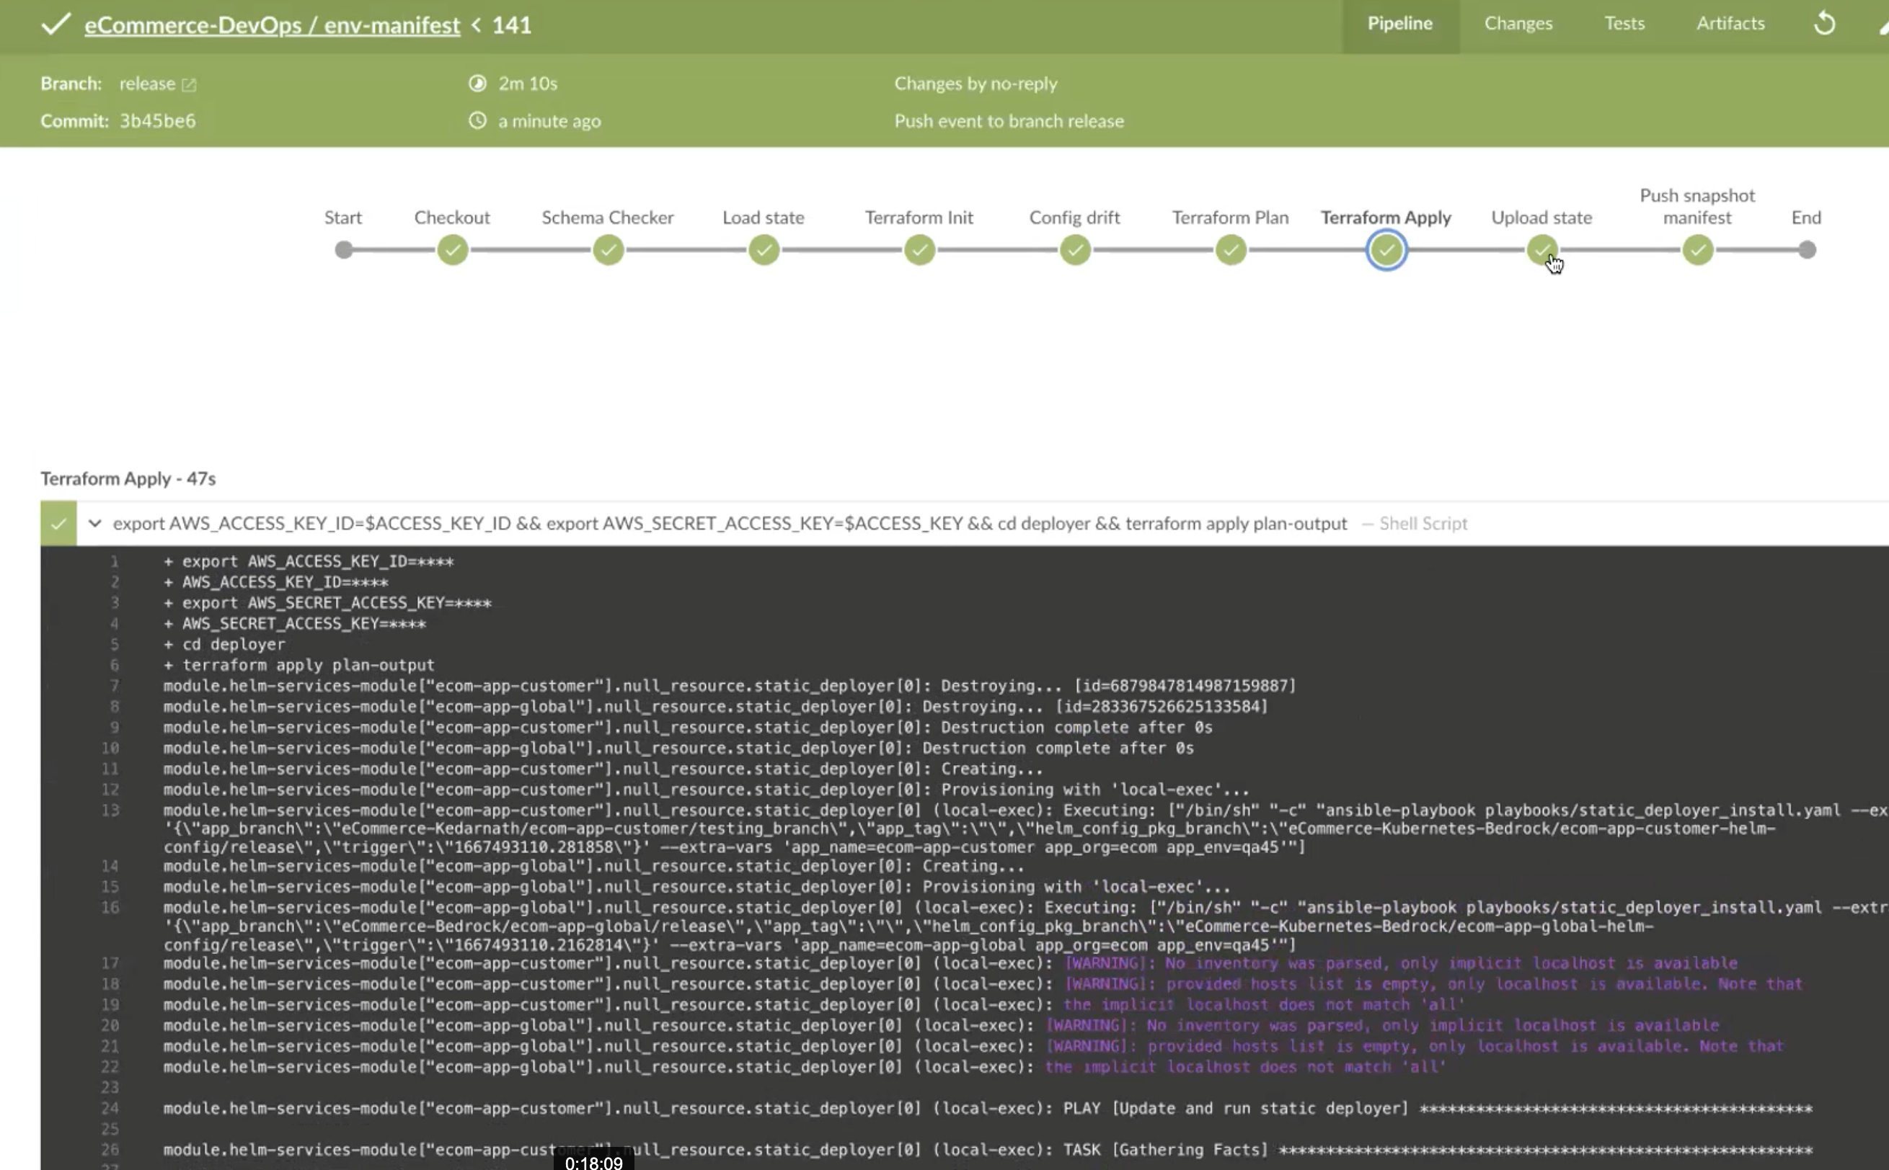
How to use it – Planning vs Applying
On PR merge, the Jenkins build will apply those changes to the infrastructure

Slide 10
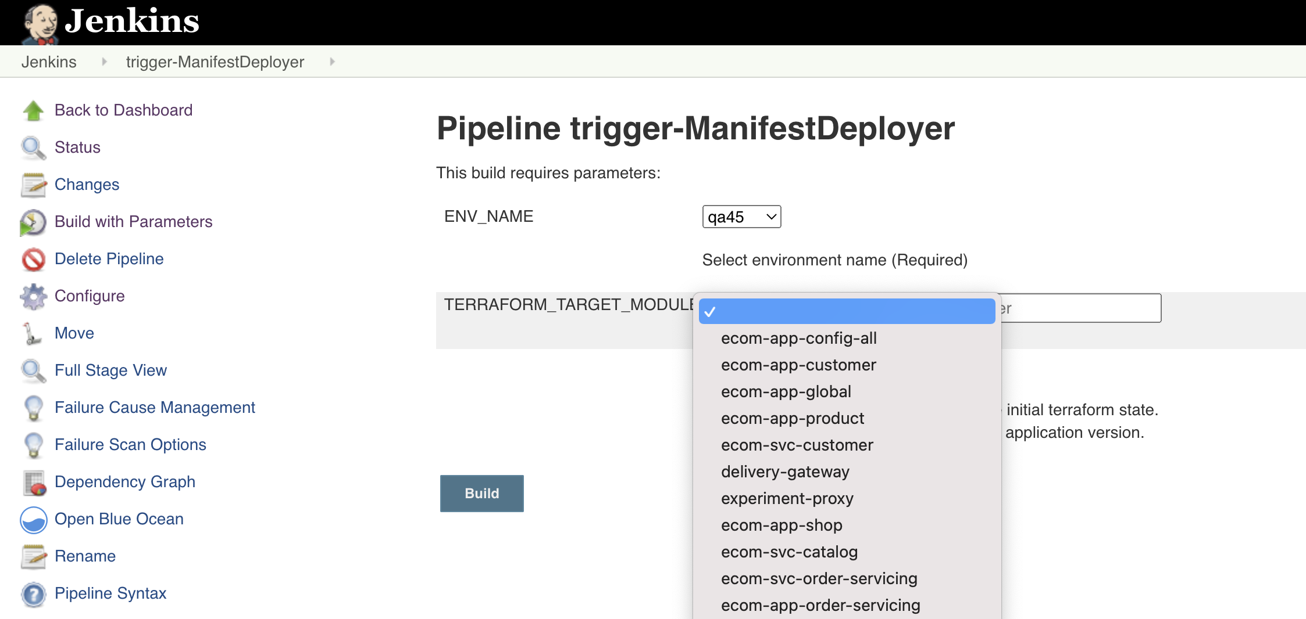
How to use it – Manual Deployment
Sometimes a manual run of the manifest deployer is needed in cases such as
Bedrock release build failed with part of manifest applied
Deploy latest rpm package for a VM application
Config drift
Manual Deployer job

Slide 11
How to use it – What to stop doing
Creating MEAD/TAH ticket for updating a particular service in an env to use specific branch and version of app and helm config
Creating MEAD/TAH ticket to update an env to start using instance x in place of instance y of a service
Directly using the update_and_run_static_deployer jenkins job for updating the static deployers
Manually configuring the static deployer job for an env and service

Slide 12
How to use it – What to continue doing
Duplicate entry task to update mfe URIs in the etcd-syncapp-config repo branch as well in manifest (needed for a short period of time)
Example: Updating shopMfe URI in all-nonprod-session branch in etcd-syncapp-config repo for qa45 env
from https://ecommerce-ecom-app-shop-eqa2.services.west.nonprod.wsgc.com/
to https://ecommerce-ecom-app-shop-eqa3.services.west.nonprod.wsgc.com/
then the manifest for qa45 also needs to be updated to use eqa3 instance of shop mfe
Duplicate entry task to update the app url properties in the helm config repos as well in manifest
Duplicate entry task to update the app in manifest when updating the app url setting using adhoc-app-settings job
If using an ephemeral instance of a service, comment out the service from manifest (Manifest does not maintain ephemeral instances)

Slide 13
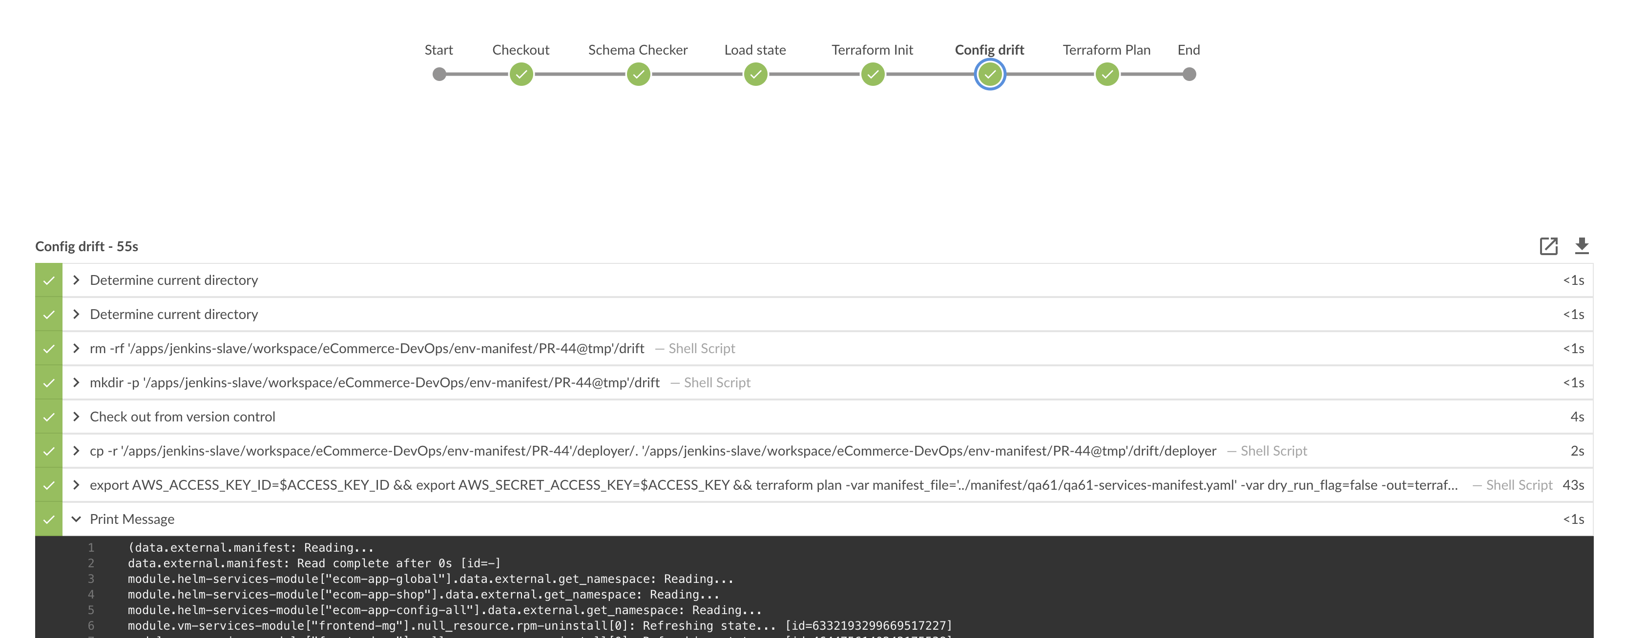
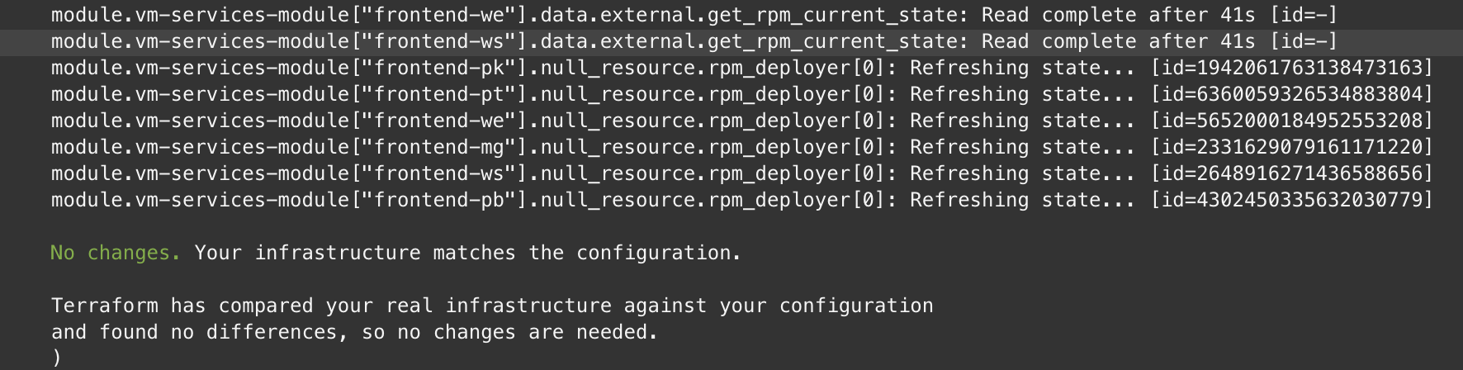
Error Handling – Config Drift
Config drift checks for the resource if it’s changed outside of the manifest process and fails the build.

Slide 14
Error Handling – Config Drift
A drift can be resolved in the below two ways
Revert the changes which were performed outside of the manifest manually to match what’s there in the manifest
Use the manifest manual deployer job to overwrite the changes on the infrastructure with the manifest. This is a two-step process
Run the manifest manual deployer job to deploy the application which has a drift. It will overwrite with what’s there in manifest
Re-run your PR jenkins job and it should see no conflict anymore.

Slide 15
Error Handling – Other errors
Race Conditions
A PR should only include a single manifest env updates.
More than one env update in a single PR will fail the build.
Other failures
Network hiccups/Jenkins restart/Intermittent Issues
Try building the PR again
For bedrock release build, use the manifest deployer to trigger the build for your env

Slide 16
Confluence resources
https://confluence.wsgc.com/display/TAH/Manifest+Config+Drift
Tracks and provides info on the config drift for all env on a scheduled basis
https://confluence.wsgc.com/display/ES/QA+Deployment+Matrix
This page in addition to maintaining the DP information about all env, now also maintains which
env are being served by manifest

Slide 17
How to get help & Useful links
To get help
#prj-ecom-env-manifest, Mead
Weekly open clinic
Useful Links
eCom Manifest User Guide: https://confluence.wsgc.com/display/TAH/Manifest+User+guide
Manifest repo: https://github.wsgc.com/eCommerce-DevOps/env-manifest
Manual Deployer: https://ecombuild.wsgc.com/jenkins/job/trigger-ManifestDeployer/

Slide 18
Q & A

